Slide 1
SharePoint App Model: Cloud-Hosted Apps
Name
Title
Company

Slide 2
Agenda
App Hosting Models
Design Considerations
Isolation
Multitenancy
Permissions
Cross Domain Calls
Provider-Hosted Apps
Windows Azure Auto-Hosted Apps

Slide 3
App Hosting Models

Slide 4
Reviewing App Hosting Options
Cloud Hosted Apps | SharePoint Hosted Apps
Preferred hosting model for almost all types of apps | Good for smaller apps & resource storage
Full power of web – choose your infrastructure & technology | SharePoint-based; no server-side code
May require your own hosting | Automatically hosted in SharePoint
May require you own handling of multitenancy & permission management | Inherent multitenancy & isolation
Notes:
SharePoint 2013’s introduces the App Model. There are two high-level categories of apps: cloud-hosted apps and SharePoint-Hosted apps.
SharePoint-Hosted Apps are great for small fully encapsulated apps that don’t have large data storage requirements. They are manifested 100% within SharePoint and any business logic must be implemented in custom code running in the client (browser) as JavaScript or another client based technology. Each SharePoint-Hosted App that is installed is isolated from other apps and thus is inherently multitenant.
SharePoint Cloud-Hosted Apps are likely the more preferred model for creating apps. This module will go into the details around cloud hosted apps. These apps enable the developer to leverage the full power of the web and select the infrastructure hosting they desire for their app. In addition, because the developer is in full control, they can elect to have their app be fully multitenant friendly based on the way it is architected.

Slide 5
Hosting: Choice of Three Architecture Approaches
Provider-Hosted App
“Bring your own server hosting infrastructure”
SharePoint Web
Your Hosted Site
Cloud-based Apps
Get remote events from SharePoint Use CSOM/REST + OAuth to work with SP
Autohosted App
Windows Azure + SQL Azure provisioned invisibly as apps are installed
SharePoint Web
Windows Azure
Websites
SharePoint-Hosted App
Provision an isolated sub web on a parent web
Reuse web elements (lists, files, out-of-box web parts)
No server code allowed; use client JavaScript for logic, UX
Parent Web
App Web (from WSP)
Notes:
Cloud Hosted Apps:
You app is hosted either in your own hosting (private cloud, 3rd party cloud, IIS web site, etc) or using an auto provisioning process in Windows Azure
Provider Hosted App
Customers can create their app in any technology stack and host on any platform they choose.
This could even be using a 3rd party cloud using PHP and developed using Eclipse.
Developers would then create a SharePoint app package that would define how to extend SharePoint for use with the app
Menu extensions
Web Parts
Ribbon extensions
App permissions (OAuth app principal ID)
Windows Azure Auto-Provisioned App
Create a SharePoint app package
Includes the SharePoint extensions & everything needed to deploy the application to Windows Azure automatically
Uses an existing subscription in Windows Azure configured by the tenant administrators
Customers (tenant admins) would configure the subscriptions in Windows Azure where apps are deployed to and not use SharePoint resources
SharePoint Hosted Apps:
SharePoint will host the app in a special isolated subweb (SPWeb) that has all the same capabilities of a regular SPWeb.
No SharePoint 2010 sandbox thus server side code is not permitted
All logic & code runs in the client
Apps could make external service calls from the client using some provided tools

Slide 6
SharePoint Hosted vs. Cloud Hosted Apps
Comparing cloud hosted apps to SharePoint hosted apps
 | SharePoint Hosted | Cloud Hosted
App Scope | SharePoint Site | Site or Tenancy
Architecture | Web Site | Multi-Tenant App
Developer Skillset | SharePoint + HTML/JS | Full Stack
UI Technologies | SharePoint + HTML/JS | Any Web Stack
Server Code | None | Any
Storage | Lists and Doc Libs | Any
Key Limitations | No Server Code | Hosting Expertise Required
Notes:
This slide depicts some of the biggest differences between building SharePoint-Hosted & Cloud-Hosted apps.

Slide 7
Cloud Hosted Model Benefits
Not tied to any SharePoint limitations
Windows Azure
ASP.NET MVC
Not just .NET Applications; Azure supports PHP, Node.js & Java
Long running processes via Worker Roles
Access to SQL Azure, Blobs, Tables, AppFabric & Service Bus
Windows Azure Auto-Hosting
SharePoint deploys ASP.NET application & SQL Azure DB to Azure automatically when SharePoint app installed
Other Hosting
Implement using any technology desired
Communicate w/ SharePoint using open standards (REST)
Obtain permissions using open standards (OAuth)
Great for extending on-premise apps to SharePoint
Notes:
While apps can take advantage of the full power & services offered in Windows Azure, those apps built as Windows Azure Auto-Hosted apps can only leverage the web sites & SQL Azure database support with the automatic provisioning.

Slide 8
Design Considerations

Slide 9
Design Considerations
Isolation Models
Multi-Tenancy Design Considerations
Cross Domain Calls
Notes:
When building Cloud-Hosted apps, there are three things one must pay attention to. Three design considerations when building apps include:
Isolation Model
Multi-Tenant Designs
Cross Domain Calls

Slide 10
Isolation Models
Instance Isolation
Multi-Tenancy
fabrikam.yourapp.com
yourapp.com
View
Logic
DB
DB
View
Logic
Host
contoso.yourapp.com
Host
View
Logic
DB
Host
Consider Azure Auto-Provisioned Apps
Notes:
Isolation of app instances, specifically the data and the experience, is critical in in Cloud-Hosted apps. Consider two beverage companies who each have special recipes for their secret formula. It would be very bad if they could see each other’s data.
The new app model enables developers to design apps using the architecture of their choice. For Azure Auto-Hosted apps, each app gets it’s own instance in Windows Azure and is completely isolated from other customers. In a true multi-tenancy app you share the presentation & business logic, but the data must be partitioned for each customer; the separation between two tenants is handled by the business logic rather then by maintaining two separate instances of the app. This is an important point to consider in the design of cloud-hosted apps.

Slide 11
Multi-Tenancy Design Considerations
Manage Tenant and User AuthN/AuthZ
Partitioned Storage
Partitioned Data Access Code
Scalable Core Infrastructure
Runtime Isolation
Compliance for Data Storage
Customer Support
yourapp.com
DB
View
Logic
Host
Notes:
When an app leverages a multi-tenant design, special care must be taken when architecting the application. Things to consider:
Managing tenants & user authentication & authorization for each client
Partitioning storage – keeping each tenant’s data isolated from other tenants
Partitioning data access logic – ensure that tenants can’t access each others data in shared data access
Runtime insolation – tenant running in the same process
Account for a scalable infrastructure (stateless)
Compliance for data storage – even for SMB’s, it is a very involved process to get certifications required for business data when building your own data center for retaining customer data in a hosted model

Slide 12
Application Permissions
SharePoint apps request set of permissions when provisioned in a SharePoint site
Read / Write / Manage / Full Control
Map to perm. levels: Read / Contribute / Design / Full Control
SharePoint 2013 utilizes OAuth used to grant app permissions to content within SharePoint
App permissions are scoped at lists, sites & site collections

Slide 13
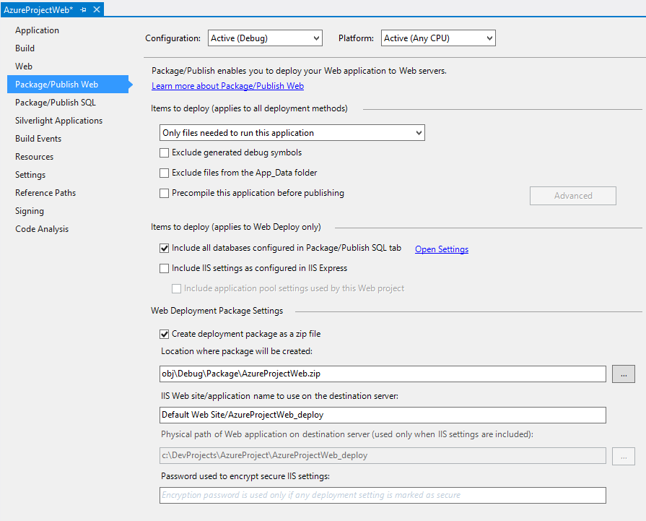
SharePoint App Config Requirements
SharePoint App – appManifest.xml
StartPage: relative reference to start page for project
Azure Project Settings
SharePoint populates web.config when provisioning Azure components*
ClientID, ClientSecret
* Applies only to Windows Azure Auto-Hosted Apps
Notes:
SharePoint apps have an appManifext.xml file. This tells SharePoint everything it needs to know about the app. The StartPage element tell SharePoint where the base parts of the app reside.
In the case of Cloud apps that are created as Windows Azure Auto-Hosted apps, the Azure project configuration needs three settings in the configuration file. These properties are managed by SharePoint when it creates and deploys the app to Azure.

Slide 14
App & SharePoint Communication
Cloud hosted apps need to interact with SharePoint
Data access
Perform certain functions (create lists, edit permissions, etc.)
App to SharePoint communication via CSOM & REST
Apps granted permission to access SharePoint new SharePoint 2013 support for OAuth

Slide 15


Cross Domain Calls Blocked By Default
http://spo.com/site/
http://tenant-xyz.spo.com/site/
http://nonSpDomain/
Browser hosted from SP Domain
Browser hosted from App Domain
Browser hosted on non SP domain
Your app JavaScript never runs in this domain
doesn’t work due to browser cross-domain, or does it?
client
server
web services hosted from SP domain
restricted set of web services hosted from app domain
SharePoint Server
(no custom server code)
Azure Server
you can’t put code here!
Notes:
Now, because apps (and their pages) run outside of SharePoint and would need to call back into SharePoint from the client-side to talk to the data, if nothing is done it will cause a problem as cross domain calls, otherwise known as cross site scripting (XSS) are blocked by default.
This is not an issue obviously when communication is initiated from the server side code as there are not cross domain call limitations with server side code.

Slide 16

Resovlved with Cross Domain JS Library
http://spo.com/site/
http://tenant-xyz.spo.com/site/
http://nonSpDomain/
Browser hosted from SP Domain
Browser hosted from App Domain
Browser hosted on non SP domain
CSOM/REST via POSTMESSAGE to IFRAMES
SP.RequestExecutor.js
client
proxy.aspx
server
web services hosted from SP domain
restricted set of web services hosted from app domain
SharePoint Server
(no custom server code)
Azure Server
Notes:
To address this SharePoint has implemented a cross domain JS library that makes it easier for developers to work with their application from the client side. Now the pages in apps can use the SP.RequestExecutor.js which uses a proxy page that is hosted inside of SharePoint that will route the call to the correct place within the SharePoint site.

Slide 17
Cross-Domain Calls - Components
JavaScript Library SP.RequestExecutor.js
Located in LAYOUTS directory
Domain Registration
To ensure only trusted calls cross domains
Specific App permissions must be granted
Communication
Hidden IFrame
Post Messaging
Proxy Page
Notes:
As web applications grow in popularity, web developers have become more aware of a significant limitation: Browsers do not allow page elements to interact with more than one domain. Allowing such interactions would expose both users and servers to cross-domain attacks. Nevertheless, modern apps incorporate information from several different data sources that most likely will reside in different domains. By using the cross-domain library, you can incorporate information from SharePoint to your apps that reside in a different domain. The cross-domain library includes some features to help you avoid the common risks of cross-domain attacks.
The cross-domain library includes several elements to make this interaction possible. SharePoint provides a JavaScript library that takes care of making secure cross-domain calls to SharePoint. Underneath the covers the library uses a hidden IFrame along with post messaging and a proxy page to route calls to SharePoint; routing happens client-side as opposed to server-side.

Slide 18
Provider Hosted Apps

Slide 19
Creating Provider Hosted Apps
Identical process for creating Windows Azure apps
Difference depending on technology used to develop & host custom application
Leverage same SharePoint 2013 investments for permissions (OAuth) & communication (REST / CSOM)
Deployment
Deploy application & SharePoint components separately
Scenario: SharePoint-ifying existing ISV offering
Notes:
Cloud apps developed as developer hosted apps, in other words those apps that are not Windows Azure Auto-Hosted, use the same process as Windows Azure Auto-Hosted apps. The big difference is that all pieces must be deployed by the developer & manually wired up. For example, a multi-tenant application may reside in a single Windows Azure instance. Users could acquire the app that leverages the multi-tenant application via the Marketplace. Once installed/added to a SharePoint site, some account/configuration data can be entered to configure the user’s partition in the hosted service. The developer must take into account the architecture & infrastructure configurations to get this deployment to support this model.

Slide 20
Provider-Hosted SharePoint App Model
demo

Slide 21
Lifecycle: Building Provider Hosted Apps
Cloud App
Register app with ACS
Use developer tools to build & debug in your technology of choice
Visual Studio
Eclipse
Configure OAuth in App config
SharePoint Package
Use Visual Studio to build app package
Focus on app entry points
Custom Actions
Client Web Parts
Carefully consider AppWeb context
No app webs for tenant scoped apps
Test on developer site

Slide 22
Lifecycle: Deploying Provider Hosted Apps
Cloud App
Deploy to production app host
SharePoint Package
Verify production OAuth configuration
Verify production references
Publish app package to:
Marketplace
Corporate Catalog

Slide 23
Lifecycle: Upgrading Provider Hosted Apps
Cloud App
All previous version of your app are in circulation
Beware of deleting & renaming resources
SharePoint Package
If necessary, update the app package
Upgrades are never forced
Tenant admin / users initiate
Test upgrade from all previous versions to current version
Publish updated app to:
Marketplace
Corporate Catalog
Notes:
Cloud App:
Consider that all previous versions are deployed and possibly installed
Don’t do common sense things: don’t delete pages that may be referenced from previous versions
SharePoint Package:
Upgrades are never forced on users
Upgrades must be initiated by tenant admins / users
Because upgrades are never forced & are instead initiated by tenant admins / users, and because previous versions may be in use, you should always test upgrading from any version to the current version

Slide 24
Windows Azure Auto-Hosted Apps

Slide 25
Windows Azure Auto-Hosted Apps
Features
Shared IIS Hosting
SQL Azure Databases
Transactional App Lifecycle
Scale Up & Out
Service Level Agreement (SLA)
Redundant Storage
Disaster Recovery
Shared Customer Support for App Issues
Payment
Customer pays for hosting as part of app cost
Notes:
Features:
Installation: SharePoint deploys a Web application to Windows Azure automatically when a user installs an instance of the app from the marketplace. If included, a SQL Azure server/database is created as well and the two applications are wired together using an auto-provisioned connection string.
Lifecycle: When apps are installed in SharePoint, new infrastructure investments address the challenges of upgrading and uninstalling the apps, something developers had to spend a considerable amount of time on previously when creating their applications.
Scale: This new model assists with the management and billing of scaling applications both up and out as demand increases and/or as they accumulate more and more data throughout the course of their lifetime.
Service Level Agreement:
The new model of SharePoint apps in Office365 & Windows Azure offer 99.9% uptime guarantee and all data is retained redundant storage.
Payment:
Cloud-hosted apps, specifically those hosted on Windows Azure (such as Auto-Hosted ones), incur an additional cost over SharePoint hosting costs. Customers will be responsible for this extra hosting cost.

Slide 26
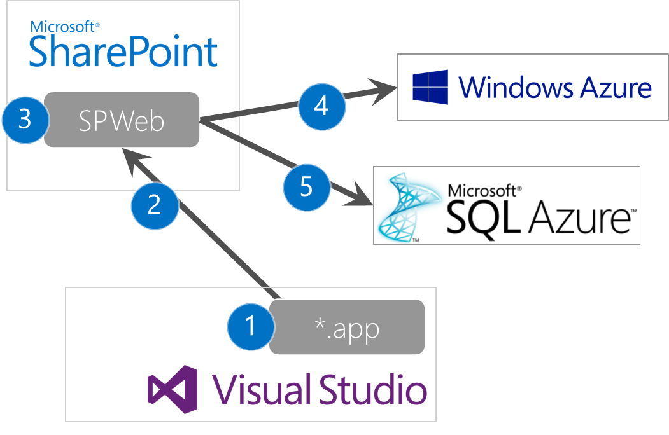
Azure Auto-Hosted: How it Works
Development & Deployment Process
Developer builds SharePoint Application into *.APP file
Deployment to SharePoint
(via Marketplace)
SharePoint installs application
SharePoint provisions Windows Azure components
SharePoint provisions SQL Azure DB & runs schema & initial data population scripts
Notes:
Developer builds SharePoint application and packages into a *.APP file.
Deployment to SharePoint
SharePoint installs application
If SharePoint application contains Windows Azure components, SharePoint provisions the Azure app
As with #4, SharePoint can provision SQL Azure, run the DDL for schema creation & DML for loading initial data

Slide 27
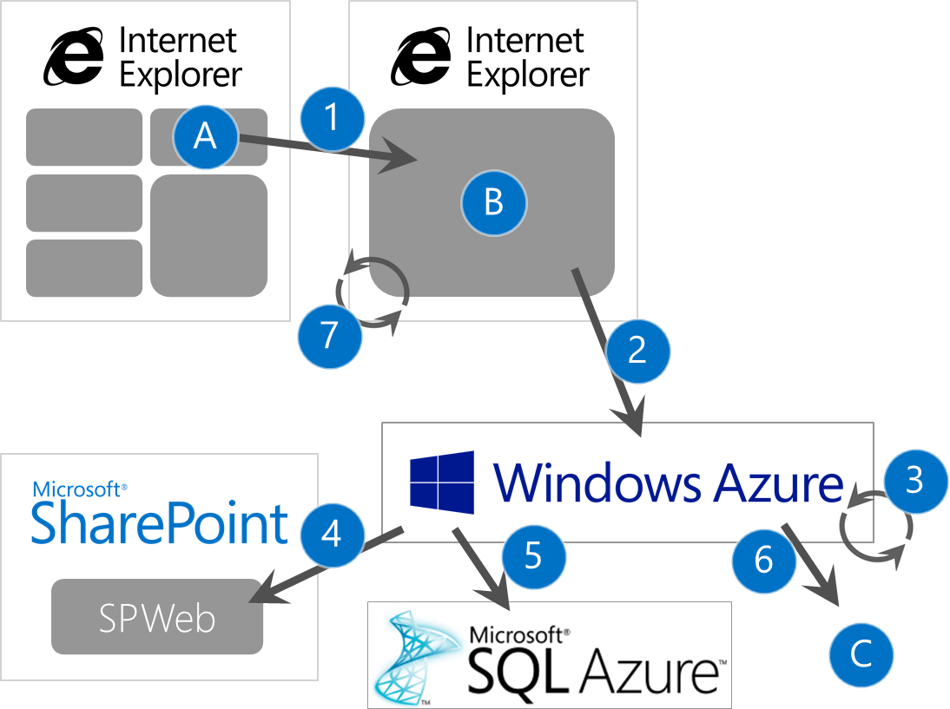
Azure Auto-Hosted: How it Works
Application Execution (End User)
User clicks app (A); SP loads app specific page (B)
Content area (B) loads Windows Azure page
Azure app executes Web app
Azure app can interact with SP using via Client Object Model (CSOM) or using the new OData services
Azure app can utilize SQL Azure DBs
Azure app can interact w/ external services or resources available over the wire (C)
Azure app can interact between the SPWeb hosting the application (B) and the application.
Notes:
User navigates to an application page in SharePoint that contains the installed apps. Upon clicking one app (A), the page reloads with the main content (B) area replaced with an SPFrame control (think of this as an enhanced IFrame).
The content area (B) in the SharePoint page points to the homepage of the application that lives in Windows Azure. This application runs entirely within Windows Azure.
The application can consist of a series of multiple ASPX pages as an Azure Web Role or Azure MVC Web Role.
The Windows Azure application can call back to SharePoint using the enhanced Client Object Model (CSOM) or using the new OData services in SharePoint Server 2013. This is useful when accessing data in SharePoint lists or other SharePoint interactions are necessary.
The Windows Azure application can also utilize SQL Azure for custom data that is used exclusively by the application.
The Windows Azure application can also call other external services or resources available over the wire (C) that are not available in SharePoint or in Windows Azure. This could be used to communicate back with on-premise LoB systems or other 3rd party hosted solutions.
In addition the application can also utilize a bridge between the SPFrame hosting the application (B) and the application. This could be used to alter the SharePoint ribbon or other SharePoint UI components (status bar, notification messages, dialogs, etc).

Slide 28
SharePoint Apps With Windows Azure
demo

Slide 29
Lifecycle: Building Azure Auto-Hosted Apps
SharePoint Package
Use Visual Studio SharePoint App Project
Focus on app entry points
Custom Actions
Client Web Parts
Carefully consider AppWeb context
No app webs for tenant scoped apps
Debug/test locally or on developer site
Web App & Database
Add Web app to solution
Add SQL Azure database
*.DACPAC required to create the SQL Azure DB
Provide data script to seed data
Debug locally
Azure Web site support
Notes:
DACPAC has built in schema for upgrading schema

Slide 30
Lifecycle: Deploying Azure Auto-Hosted Apps
SharePoint Package
OAuth config & SQL Azure connection string auto-generated
Use ~remoteAppUrl token for references to web app URL
Publish app package to:
Marketplace
Corporate Catalog
Web App & Database
Packaged in SharePoint package
Auto-provisioned & deployed to Windows Azure

Slide 31
Lifecycle: Upgrading Azure Auto-Hosted Apps
SharePoint Package
Upgrade orchestrated by SharePoint
Original set to read-only mode
Copy, upgrade in parallel for all layers
On success: swap two sites
On error: roll back
Similar to the Windows Azure staging/production & swap VIP process
Web App & Database
Web App
Upgrade creates new instance
Database
*.DACPAC supports best effort schema upgrade
Beware of deletes & renames
Use data script to massage data

Slide 32
Summary
App Hosting Models
Design Considerations
Isolation
Multitenancy
Cross Domain Calls
Permissions
Developer-Hosted Apps
Windows Azure Auto-Hosted Apps

Slide 33
Q&A

Slide 34

© 2012 Microsoft Corporation. All rights reserved. Microsoft, Windows, Windows Vista and other product names are or may be registered trademarks and/or trademarks in the U.S. and/or other countries.
The information herein is for informational purposes only and represents the current view of Microsoft Corporation as of the date of this presentation. Because Microsoft must respond to changing market conditions, it should not be interpreted to be a commitment on the part of Microsoft, and Microsoft cannot guarantee the accuracy of any information provided after the date of this presentation. MICROSOFT MAKES NO WARRANTIES, EXPRESS, IMPLIED OR STATUTORY, AS TO THE INFORMATION IN THIS PRESENTATION.

